Slide 1
Miss B’s Maths
DIRT Bank
Created by teachers for teachers, to help improve the work life balance and also the consistent quality of feedback our students receive.
This aims to be a continuously evolving document.
Please contribute to the DIRT Bank simply by emailing your DIRT question(s) you’ve created and your name/twitter handle to missbsresources@gmail.com and I will update weekly.
DIRT

Slide 2
DIRT
Template
Sub Topic

Slide 3
DIRT
Template
Subtopic

Slide 4
Contents
Number
DIRT
Topic | Contributor | Twitter Handle
Multiplying 3 digit by 1 digit (grid) | Danielle Bartram | @Missbsresources
Multiplying 3 digit by 1 digit (Long) | Danielle Bartram | @Missbsresources
Multiplying 3 digit by 2 digit (grid) | Danielle Bartram | @Missbsresources
Multiplying 3 digit by 2 digit (Long) | Danielle Bartram | @Missbsresources
Multiplying by scalars of 10 | Danielle Bartram | @Missbsresources
Multiplying decimals | Danielle Bartram | @Missbsresources
Dividing decimals | Danielle Bartram | @Missbsresources
Functional division 1 | Danielle Bartram | @Missbsresources
Functional division 2 | Danielle Bartram | @Missbsresources
Addition and subtraction 1 | Danielle Bartram | @Missbsresources
Addition and subtraction 2 | Danielle Bartram | @Missbsresources
Directed numbers four rules | Danielle Bartram | @Missbsresources
Functional Temperature 1 | Danielle Bartram | @Missbsresources
Functional Temperature 2 | Danielle Bartram | @Missbsresources
Ordering Decimals | Danielle Bartram | @Missbsresources
Rounding nearest 10 | Danielle Bartram | @Missbsresources
Significant Figures | Danielle Bartram | @Missbsresources
Rounding using a calculator 1 | Danielle Bartram | @Missbsresources
Rounding using a calculator 2 | Danielle Bartram | @Missbsresources
Laws of Indices | Danielle Bartram | @Missbsresources
Inequality Notation 1 | Danielle Bartram | @Missbsresources
Inequality Notation 2 | Danielle Bartram | @Missbsresources
Solving Inequalities | Danielle Bartram | @Missbsresources
Bounds nearest unit | Danielle Bartram | @Missbsresources
Bounds nearest (1dp) | Danielle Bartram | @Missbsresources
Bounds nearest (1dp) | Danielle Bartram | @Missbsresources
Bounds Area | Danielle Bartram | @Missbsresources

Slide 5
Contents
Number
DIRT
Topic | Contributor | Twitter Handle
Simplifying Fractions | Peter Hall | @MathsAST
Simplifying Fractions | Peter Hall | @MathsAST
Calculate missing numerator | Peter Hall | @MathsAST
Calculate missing numerator | Peter Hall | @MathsAST
Finding multiplier | James Prout | @proutmaths
Percentage change | James Prout | @proutmaths
Successive percentage change (compound interest) | James Prout | @proutmaths
Reverse Percentage | James Prout | @proutmaths

Slide 6
Contents
Geometry
DIRT
Topic | Contributor | Twitter Handle
Area and Perimeter ($cm^{2} grid)$ | Danielle Bartram | @Missbsresources
Area and Perimeter half squares ($cm^{2} grid)$ | Danielle Bartram | @Missbsresources
Area of a Triangle | Danielle Bartram | @Missbsresources
Area of a Parallelogram | Danielle Bartram | @Missbsresources
Area of a Trapezium | Danielle Bartram | @Missbsresources
Parts of a Circle | Danielle Bartram | @Missbsresources
Circumference of a Circle | Danielle Bartram | @Missbsresources
Area of a Circle | Danielle Bartram | @Missbsresources
Arc Length | Danielle Bartram | @Missbsresources
Area of a Sector 1 | Danielle Bartram | @Missbsresources
Area of a Sector 2 | Danielle Bartram | @Missbsresources
Perimeter of Rectilinear Shapes | Danielle Bartram | @Missbsresources
Area of Rectilinear Shapes | Danielle Bartram | @Missbsresources
Area of Compound Shapes | Danielle Bartram | @Missbsresources
Volume – Counting Cubes | Danielle Bartram | @Missbsresources
Volume – Cuboid | Danielle Bartram | @Missbsresources
Volume – Triangular Prism | Danielle Bartram | @Missbsresources
Volume – Cylinder | Danielle Bartram | @Missbsresources
Volume – Hemisphere | Danielle Bartram | @Missbsresources
Volume – Sphere/Cone (Ice Cream) | Danielle Bartram | @Missbsresources
Dimensions | Danielle Bartram | @Missbsresources
Surface Area – Cuboid | Danielle Bartram | @Missbsresources
Surface Area – Cylinder | Danielle Bartram | @Missbsresources
Pythagoras – Identify Hypotenuse | Danielle Bartram | @Missbsresources
Pythagoras – Missing Hypotenuse 1 | Danielle Bartram | @Missbsresources
Pythagoras – Missing Hypotenuse 2 | Danielle Bartram | @Missbsresources
Pythagoras – Missing Short Side | Danielle Bartram | @Missbsresources
Pythagoras – 3D Cuboid | Danielle Bartram | @Missbsresources
Pythagoras – Isosceles Triangle | Danielle Bartram | @Missbsresources
Trigonometry – 3D Square-based pyramid | Danielle Bartram | @Missbsresources

Slide 7
Contents
Geometry
DIRT
Topic | Contributor | Twitter Handle
Missing Angle inside a Triangle | Peter Hall | @MathsAST
Missing Angle inside a Quadrilateral | Peter Hall | @MathsAST
Missing Angle on a Straight Line | Peter Hall | @MathsAST
Missing Angle around a point | Peter Hall | @MathsAST
Circle Theorem – cyclic quad | Joanna Bacon | @jojobee21
Circle Theorem – Alternate | Joanna Bacon | @jojobee21
Circle Theorem - Tangent | Joanna Bacon | @jojobee21
Circle Theorem - Segment | Joanna Bacon | @jojobee21

Slide 8
Contents
Algebra
DIRT
Topic | Contributor | Twitter Handle
Sequences – Worded Rule | Caroline Beale | @cbeale83
Sequences – Missing Number | Caroline Beale | @cbeale83
Sequences – Finding term numbers from given rule. | Caroline Beale | @cbeale83
Sequences – Geometric and Arithmetic | Caroline Beale | @cbeale83
Sequences – nth term rule | Caroline Beale | @cbeale83
Forming an expression (add/subtract) | Danielle Bartram | @Missbsresources
Forming an expression (multiply/divide) | Danielle Bartram | @Missbsresources
Simplifying Expressions | Danielle Bartram | @Missbsresources
Expanding single brackets | Danielle Bartram | @Missbsresources
Expand and Simplify single brackets | Danielle Bartram | @Missbsresources
Expanding Single brackets | Danielle Bartram | @Missbsresources
Expanding double brackets | Danielle Bartram | @Missbsresources
Expanding double brackets with a coefficient. | Danielle Bartram | @Missbsresources
Factorising Single Brackets (HCF) | Danielle Bartram | @Missbsresources
Factorising Single Brackets (Division) | Danielle Bartram | @Missbsresources
Factorising Single Bracket (Variable) | Danielle Bartram | @Missbsresources
Factorising double brackets | Danielle Bartram | @Missbsresources
Algebraic Fractions - Multiply | Danielle Bartram | @Missbsresources
Algebraic Fractions - Add | Danielle Bartram | @Missbsresources
Algebraic Fractions - Factorise | Danielle Bartram | @Missbsresources
Substitute into an Expression | Danielle Bartram | @Missbsresources
Substitute into worded formula | Danielle Bartram | @Missbsresources
Substitute and reverse worded formula | Danielle Bartram | @Missbsresources

Slide 9
Contents
Algebra
DIRT
Topic | Contributor | Twitter Handle
Substitute into science formula | Danielle Bartram | @Missbsresources
Deduce possible variables. | Danielle Bartram | @Missbsresources
Write a formula in words | Danielle Bartram | @Missbsresources
Substitute into scientific formula | Danielle Bartram | @Missbsresources
Form and solve Equations Perimeter | Danielle Bartram | @Missbsresources
Form and solve Equations Simple Functional | Danielle Bartram | @Missbsresources
Form and solve Equations I think of a number… | Danielle Bartram | @Missbsresources
Form and solve Equations Rectangles have same Area. | Danielle Bartram | @Missbsresources
Solving one-step equations Add/Subtract | Danielle Bartram | @Missbsresources
Solving one-step equations Multiply/Divide | Danielle Bartram | @Missbsresources
Solving two-step equations | Danielle Bartram | @Missbsresources
Solving two-step equations With Brackets | Danielle Bartram | @Missbsresources
Solve Equations Unknowns on both sides | Danielle Bartram | @Missbsresources
Solve Equations Unknowns on both sides | Danielle Bartram | @Missbsresources
Solve Equations with bracket Unknowns on both sides | Danielle Bartram | @Missbsresources
Solve Equations with brackets Unknowns on both sides | Danielle Bartram | @Missbsresources

Slide 10
Contents
Algebra
DIRT
Topic | Contributor | Twitter Handle
Solving Inequalities Unknowns on both sides | Danielle Bartram | @Missbsresources
Represent the solution set | Danielle Bartram | @Missbsresources
Solving Inequalities with brackets Unknowns on both sides | Danielle Bartram | @Missbsresources
Solving quadratics - Factorising | Danielle Bartram | @Missbsresources
Simultaneous Equations Multiply both | Danielle Bartram | @Missbsresources
Simultaneous Equations Worded | Danielle Bartram | @Missbsresources
Trial and improvement | Danielle Bartram | @Missbsresources
Change the subject – simple | Danielle Bartram | @Missbsresources
Change the subject Square and Square Root | Danielle Bartram | @Missbsresources
Change the subject Factorise | Danielle Bartram | @Missbsresources
Reading Coordinates (1 quadrant) | Danielle Bartram | @Missbsresources
Plotting Coordinates (1 quadrant) | Danielle Bartram | @Missbsresources
Read and Plot (4 Quadrants) | Danielle Bartram | @Missbsresources
Mid Point of Coordinates | Danielle Bartram | @Missbsresources
Identify the rule of a line | Danielle Bartram | @Missbsresources
Plotting rules of a line | Danielle Bartram | @Missbsresources
Plotting straight line graphs | Danielle Bartram | @Missbsresources
Identifying graphs and features | Danielle Bartram | @Missbsresources
Plotting Quadratic graphs | Danielle Bartram | @Missbsresources
Equation of a line. | Danielle Bartram | @Missbsresources
Identifying parallel lines from an equation | Danielle Bartram | @Missbsresources
Gradient and equation of line | Danielle Bartram | @Missbsresources

Slide 11
Contents
Algebra
DIRT
Topic | Contributor | Twitter Handle
Equation of line parallel when given coordinate | Danielle Bartram | @Missbsresources
Equations of perpendicular lines | Danielle Bartram | @Missbsresources
Identifying quadratic, cubic, reciprocal and exponential graphs | Danielle Bartram | @Missbsresources
Plotting exponential graphs | Danielle Bartram | @Missbsresources
Inequality Region graphs | Danielle Bartram | @Missbsresources
Solving Quadratics Factorising | Danielle Bartram | @Missbsresources
Quadratic Formula | Danielle Bartram | @Missbsresources
Quadratic and linear Simultaneous equation | Danielle Bartram | @Missbsresources
Complete the Square | Danielle Bartram | @Missbsresources
Solving algebraic fractions | Danielle Bartram | @Missbsresources

Slide 12
Contents
Algebra
DIRT
Topic | Contributor | Twitter Handle

Slide 13
Contents
Data Handling
DIRT
Topic | Contributor | Twitter Handle
Sample Space | Danielle Bartram | @Missbsresources
Combinations | Danielle Bartram | @Missbsresources
Relative Frequency | Danielle Bartram | @Missbsresources
Expected Probability | Danielle Bartram | @Missbsresources
Missing Probability | Danielle Bartram | @Missbsresources
Far/Unfair Bias | Danielle Bartram | @Missbsresources
Independent Tree | Danielle Bartram | @Missbsresources
Dependent Tree | Danielle Bartram | @Missbsresources
Independent Tree | Danielle Bartram | @Missbsresources
Decimal Tree | Danielle Bartram | @Missbsresources
Dependent Events | Danielle Bartram | @Missbsresources
Dependent Events | Danielle Bartram | @Missbsresources

Slide 14
Contents
Problem Solving
and Functional
DIRT
Topic | Contributor | Twitter Handle

Slide 15
DIRT
Number
Multiplication
Calculate 273 x 4
Calculate 247 x 3
× | 4
 | 800
70
3
Calculate $273×4$
Calculate $247×3$
 | 2 | 7 | 3
 |  |  | 4
 |  |  | 2
$$×$$
1
Complete the multiplication and add the exchanged (carried) numbers.
Calculate $354×27$
Calculate $634×5$2
× | 20
300 |  | 2100
 | 1000
4
Calculate $354×27$
Calculate $634×5$2
 | 3 | 5 | 4
 |  | 2 | 7
2 | 4 | 7 | 8
 |  |  | 0
$$×$$
Complete the multiplication and add the exchanged (carried) numbers.
+

Slide 16
DIRT
Number
Multiplication
Calculate $3.9 ×100$
Calculate $2.7 ×1000$
Th | H | T | U | . | $$\frac{1}{10}$$
 |  |  | 3 | . | 9
 | 3 |  |  | .
Calculate $0.97 ×100$
Fill in the gaps.
Calculate $15×0.6$
9 x 0.3
9 x 3 = 27
1dp in the question, so 1dp in the answer
9 x 0.3 = 2.7
Show all working out.
Calculate $0.15×0.6$
Show all working out.

Slide 17
DIRT
Number
Division
The school minibus seats 14 children. 60 children need to go to the cricket tournament. How many times must the bus make the trip.
50 people are going to a meeting in the school hall. We need chocolate brownies for everyone but they come in packs of 6. How many packs do we need to buy?
$$60÷14=$$
14
?
14
14
14
The school minibus seats 14 children. 365 children need to go to the cricket tournament. How many times must the bus make the trip.
359 people are going to a meeting in the school hall. We need chocolate brownies for everyone but they come in packs of 6. How many packs do we need to buy?
$$365÷14=$$
14
Answer:
Calculate $518÷0.7$
Calculate $245÷0.4$
Show all working out.
Show all working out.
$$5180$$
$$0.7$$
$$7$$
$$518$$
Make it a whole number.
$×10$ to both numbers

Slide 18
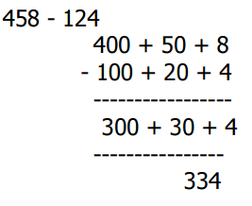
DIRT
Number
Addition and Subtraction
Addition
Subtraction
Work out the following.
 | 4 | 2 | 6
 | 3 | 5 | 7
 | 5 | 6 | 8
 | 2 | 4 | 7
+
Addition
Subtraction
Work out the following.
 | 3 | 6 | 7
 | 1 | 8 | 5
 | 4 | 2 | 6
 | 3 | 5 | 7
+
 | 5 | 3 | 8
 | 2 | 4 | 7
 |  |  | 1
+
 | 4 | 7 | 5
 | 2 | 4 | 7
$$−$$

Slide 19
DIRT
Number
Directed Numbers
How much is this?
Factor 1 | Factor 2 | Product
₊ | ₊
₋₋ | ₋₋
₋₋ | ₊
₊ | ₋₋
+4 – +3 =
+5 × +3 =
-
+4 – –3 =
–5 × +3 =
+
+4 + –3 =
–5 × –3 =
+
+
– 4 – +3 =
+6 ÷ –2 =
-
– 4 – –3 =
–6 ÷ –2 =
– 4 + –3 =
2
1
0
-1
-2
-3
-4
Overnight, the temperature dropped from 2 ºC to -4 ºC. By how many degrees did the temperature fall?
One day the level of the water in a river was 8cm above its average level. One week later it was 6cm below its average level. How far did the water level drop in the week?
1
0
-1
-2
-3
-4
-5
The table shows the temperatures in four cities. Calculate the difference between he highest and lowest temperature.
At 7am, Joe recorded the temperature in his garden as being −4°C. He went back outside at 1pm and found that the temperature had increased by 12°C. What was the temperature at 1pm?
London | $$0^{o}C$$
Moscow | $$−9^{o}C$$
Paris | $$6^{o}C$$
Berlin | $$−3^{o}C$$
Highest:
Lowest: Difference:

Slide 20
DIRT
Number
Place Value
Place the decimals in ascending order.
Place the decimals in ascending order.
$0.602, 0.26, 6.02, 0.026, 0.06, 0.6$
Units | . | $$\frac{1}{10}$$ | $$\frac{1}{100}$$ | $$\frac{1}{1000}$$
0 | . | 4 | 5
0 | . | 0 | 0 | 4
0 | . | 4 | 0 | 5
0 | . | 5

Slide 21
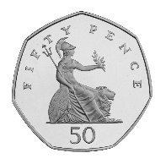
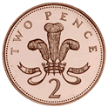
DIRT
Number
Rounding
73
70
1) Round 148 miles to the nearest hundred miles.
73 rounded to the nearest ten is 70, because 73 is closer to 70 than to 80.
76 goes up to 80, because 76 is closer to ____ than to _____.
2) To the nearest 10p how much is in Sian’s purse?
76
80
Round to 2 significant figures.
Calculate $\frac{11.7−3.1}{9.6−2.4}$
$$\frac{3.9+4.1}{7}$$
1.14285714
Write down the full calculator display.
Round to 3 significant figures.
Place holder
Calculate $\frac{\sqrt{9.83−{1.62}^{2}}}{23.8−4.47×5.12}$
Calculate $\frac{8.95+\sqrt{7,84}}{2.03×1.49}$
Work out the numerator:
Work out the denominator:
Write down the full calculator display.
Write down the full calculator display.
Correct to 3 significant figures.
Round the following numbers to 3 significant figures.
Round the following numbers to 3 significant figures.
Third significant figure Place holder
35260
2.347
3568
42062
0.024537
0.0034078

Slide 22
DIRT
Number
Fractions
Simplify$\frac{14}{21}$ Calculate the HCF of 14 and 21. Factors of 14 Factors of 21 | Simplify $$a) \frac{12}{18}$$ $$b) \frac{9}{15}$$
Simplify$\frac{14}{28}$ Calculate the HCF of 14 and 28. Factors of 14 Factors of 28 | Simplify $$a) \frac{42}{56}$$ $$b) \frac{24}{30}$$
Find the missing value $$\frac{2}{5}=\frac{??}{30}$$ | Find the missing value $$a) \frac{3}{5}=\frac{??}{15}$$ $$b) \frac{4}{5}=\frac{??}{60}$$
Find the missing value $$\frac{2}{5}=\frac{??}{30}$$ | Find the missing value $$a) \frac{3}{8}=\frac{??}{48}$$ $$b) \frac{4}{7}=\frac{??}{28}$$
1 x 14
2 x 7
HCF =
To simplify divide the numerator and _____________ of the fraction by the HCF.
1 x 14
2 x 7
HCF =
To simplify divide the numerator and _____________ of the fraction by the HCF.
$$×$$
$$Scalar=\frac{New Denominator}{Old Denominator}$$
$Scalar=\frac{30}{}$=
$$×$$
$$×$$
$$Scalar=\frac{New Denominator}{Old Denominator}$$
$Scalar=\frac{30}{}$=
$$×$$

Slide 23
DIRT
Number
Indices
Fill in the missing gaps.
$$3^{4}×3^{7}=3 =3$$
$$5^{8}×5^{6}=_________$$
$$2^{9}÷2^{5}=2 =2$$
$$7^{9}×7^{−3}=_________$$
$$2^{−1}=\frac{1}{2}$$
$$4^{12}÷4^{3}=_________$$
$$6^{−1}=_________$$

Slide 24
DIRT
Number
Inequalities
Match the inequality notation with the correct definition.
What is the largest and smallest value $x$can be?
a)$−5<x≤2$
b)$−3≤x≤0$
c) $−9<x<−1$
$$<$$
Less than or equal to
Minimum | Maximum
$$≥$$
Greater than
$$≤$$
Greater than or equal to
$$>$$
Less than
Match the inequality notation with the correct definition.
What is the largest and smallest value $x$can be?
a)$−4<x≤3$
b)$−5≤x<0$
c) $−8<x<−1$
$$≥$$
Greater than
Minimum | Maximum
$$<$$
Less than or equal to
$$≤$$
Less than
$$>$$
Greater than or equal to
Find the maximum and minimum values for $x$when $15<5x<20.$
Find the maximum and minimum values for $x$when $20<4x<56.$
$$15<5x<20$$
$$3< x <4$$
Minimum: _______ Maximum: _______
Minimum: _______ Maximum: _______

Slide 25
DIRT
Number
Bounds
Lower Bound | 21.5m
Upper Bound | 22.5m
Amjad’s height is given as 162cm, correct to the nearest cm. Between which limits does Amjad’s height lie?
A fence is m long to the nearest metre.
Lower Bound | £1.55
Upper Bound | £1.65
A box is 8.5cm wide measured to the nearest tenth of a cm. What are the upper and lower bounds?
A Krispy Crème doughnut costs to the nearest 10p.
£
Lower Bound | £1.45
Upper Bound | £1.55
A box is 10.6cm wide measured to the nearest tenth of a cm. What are the upper and lower bounds?
A Krispy Crème doughnut costs to the nearest 10p.
£
A rectangle has a length of 20cm and height of 30cm to the nearest 10cm. What is the maximum and minimum area of the rectangle?
The dimensions of a piece of carpet are given as 127cm x 68cm. Both lengths are correct to the nearest cm. Between what limits does the area of the carpet lie?
 | Minimum | Maximum
Length |  | 25cm
Width | 25cm
Area |  | 875$cm^{2}$

Slide 26
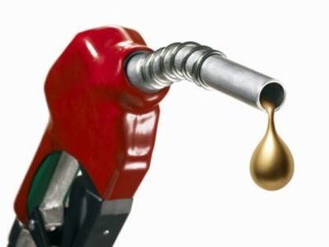
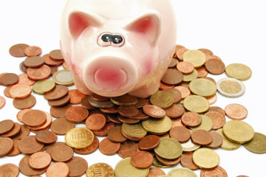
DIRT
Number
Percentages
Write these percentages as decimals | What decimal multiplier would you use to work out 42% of an amount?
Petrol prices rose from 110p per litre to 132p per litre. What was the percentage increase? | A coat originally cost £68. It now costs £57.80 in a sale. What was the percentage change?
A TV originally costs £400. It is reduced by 30% in a sale. The shop then offers a further 20% discount. How much is the TV now? | James invests £4500 in a bank account at 3% compound interest per annum (pa). How much does he have after 4 years?
After a 36% discount, a Blu-Ray player now costs £48. How much did is cost before the discount? | If you invest £ x into a bank account at 5% pa compound interest. How many years will it take to double your money?
23% | 0.23
6%
20%
150%
3.5%

Slide 27
DIRT
Geometry
Area and Perimeter
Complete the sentences
Find the area and perimeter of the shaded shape.
Area is the _____ of a shape.
Perimeter is the ________ of a shape.
Complete the sentences
Find the area and perimeter of this shape.
Count the _________ to find the area.
Count the _________ to find the perimeter.

Slide 28
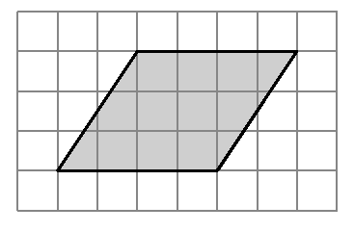
DIRT
Geometry
Area and Perimeter
Calculate the area of the triangle.
Calculate the area of the triangle.
Area $=\frac{1}{2}×base×height$
$$8 cm$$
$$11 cm$$
$$6 cm$$
$$5 cm$$
Area=______$cm^{2}$
Area=__________
Calculate the area of the parallelogram.
A right angled triangle is translated to the position shown to make a rectangles.
$$8 cm$$
The formula for the area of a parallelogram is the _________ as a rectangle.
$$11cm$$
Half the _____ of the
parallel sides.
________ the distance between them.
That is how you calculate, area of a ___________.
Calculate the area of the trapezium.
$$6 cm$$
$$5 cm$$
$$10 cm$$

Slide 29
DIRT
Geometry
Circles
Complete the sentences
Match the key terms to the diagrams.
The radius is _______ the diameter.
Diameter
The diameter is _______ the radius.
Circumference
Radius
Calculate the circumference of the circle.
Calculate the circumference of the circle.
Radius= Diameter=
$$10 cm$$
$$12 cm$$
Circumference= $πd$
Circumference= $π×diameter$
Circumference=______$c$m
Circumference=______
Calculate the area of the circle.
Calculate the area of the circle.
Radius= Diameter=
$$4 cm$$
$$3cm$$
Area = $πr^{2}$
Area = $π×radius×radius$
Area = $π×3×$
Area =______$cm^{2}$
Area =______

Slide 30
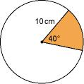
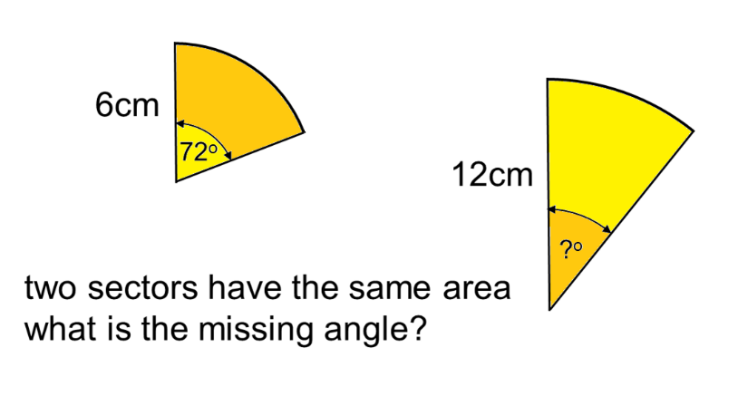
DIRT
Geometry
Circles
The formula for circumference in terms of radius is $2πr$
A
Calculate the arc lengths.
The expression for arc length is
B
Calculate the arc length AB.
360
$$×2×π×10$$
The formula for the area of a circle is
A
Calculate the area of the sectors.
The formula for the area of a sector is
B
Calculate the area of the sector.
360
$$×π×{10}^{ 2}$$
The formula for the area of a circle is
A
The formula for the area of a sector is
B
Calculate the area of the sector.
$$×π×{10}^{ 2}$$

Slide 31
DIRT
Geometry
Area and Perimeter
Find the perimeter of the shape.
$$7 cm$$
Find the perimeter of the shape.
$$5 cm$$
Not to scale.
a
Not to scale.
b
Length a = 15 -6
=____
$$15 cm$$
$$14 cm$$
$$6 cm$$
Length b = 11 -
=____
$$6 cm$$
Perimeter=_____cm
Perimeter=______
$$11 cm$$
$$12 cm$$
$$5 cm$$
Find the area of the shape.
$$7 cm$$
Find the area of the shape.
a
Not to scale.
Area a = $5×$
=____
Not to scale.
$$15 cm$$
$$14 cm$$
b
$$6 cm$$
Area b = $6×11$
=____
$$6 cm$$
Area=____$cm^{2}$
Area=______
$$11 cm$$
$$12 cm$$
Calculate the total area.
Calculate the total area.
The formula for area of a circle is_______
Area A = ___ x ___ =______$cm^{2}$
B
Area B = $\frac{πr^{2}}{2}=\frac{π{_____}^{2}}{2}$=_____$cm^{2}$
Total area= Area A + Area B
= _____+______
=________$cm^{2}$
10 cm
A
5 cm
10 cm
20 cm
Diagram not drawn accurately.
Diagram not drawn accurately.

Slide 32
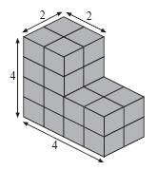
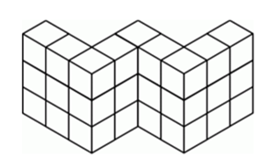
DIRT
Geometry
Volume
Find the volume of the solid prism.
Here is a solid prism made from centimetre cubes.
Volume:_____$cm^{3}$
Find the volume of the solid prism.
Calculate the volume of the cuboid.
Calculate the volume of the cuboid.
Volume = length × width × height
$$4 cm$$
$$4 cm$$
$$5 cm$$
$$3cm$$
$$5 cm$$
$$7cm$$
Volume=______$cm^{3}$
Volume=______
CSA is an abbreviation for cross sectional ________.
Calculate the volume of the cylinder.
Volume = CSA x
5 cm
CSA = $\frac{4 ×____}{2}$
6 cm
5 cm
5 cm
8 cm
10cm
4 cm
4 cm
Volume = ____ x 10
= _____$cm^{3}$
Find the volume of the cylinder.
4cm
10cm

Slide 33
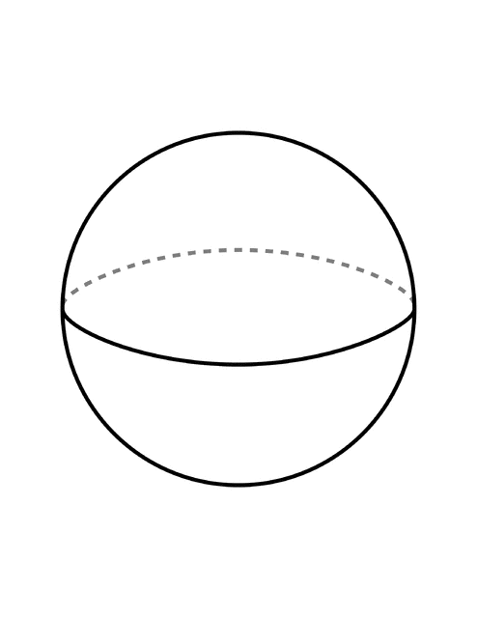
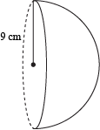
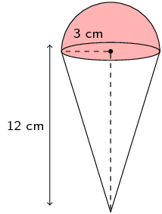
DIRT
Geometry
Volume
Calculate the surface area of the sphere.
Calculate the surface area of the sphere hemisphere with a radius of 8cm.
SA=$4πr^{2}$
8cm
10cm
The formula for the volume of a sphere is
The formula for the volume of a cone is
Calculate the volume of this strawberry ice cream and cone. Clearly show all working out.
Area is measured in units _______, because it has ____ dimensions.
Volume is measured in units _______, because it has ____ dimensions.
a, b and c are representations of lengths.
Which expressions represent volume?
$$a^{2}b$$ | $$b(a^{2}+c)$$ | $$2abc$$ | $4πb^{3}$

Slide 34
DIRT
Geometry
Surface Area
Surface area is the area of each face added together.
Calculate the surface area of the cuboid.
Sketch a net of the prism before calculating the surface area to help you visualise the faces, Include dimensions.
3cm
2cm
Write the dimensions on the net.
4cm
A
Diagram not drawn accurately.
B
3cm
C
B
C
C
A
2cm
A
4cm
B
What is the completed formula for the surface area of a cylinder?
Find the surface area of the cylinder.
$$πr^{2}$$
4cm
$$h$$
$$πD×h$$
10cm
$$πr^{2}$$
Circumference = $π×diameter$

Slide 35
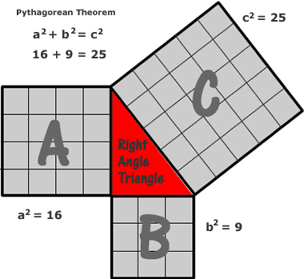
DIRT
Geometry
Pythagoras
Pythagoras’ theorem is + =
The hypotenuse is the ___________ side. It is also the side opposite the ________ angle.
Accurately label the hypotenuse with a C on each of these triangles.
Pythagoras’ theorem is + =
Calculate the missing hypotenuse lengths. (Clearly show all working out)
$$c^{2}= 4^{ 2} +3^{2}$$
7 cm
$$c^{2}=16 + 9=$$
8cm
$$w$$
$$x$$
10 cm
$$a^{2}=16$$
$$c=\sqrt{25…}=$$
$$b^{2}=9$$
6cm
Pythagoras’ theorem is + =
Calculate the missing lengths.
(Clearly show all working out)
$$x$$
$$c^{2}= 4^{ 2} +3^{2}$$
$$c^{2}=16 + 9=$$
12cm
$$w$$
15 cm
12 cm
$$a^{2}=16$$
$$c=\sqrt{25…}=$$
$$b^{2}=9$$
9cm
To find the length of a shorter side in a right-angled triangle we rearrange Pythagoras’ theorem.
Calculate the missing lengths of the shorter sides. (Clearly show all working out)
Pythagoras’ theorem is + =
$$a$$
$$z$$
$$c$$
$$b$$
$$a^{2}= {}^{ 2} − {}^{ 2}$$
$$y$$
20 cm
8.5 cm
4.2 cm
$$b^{2}= {}^{ 2} − {}^{ 2}$$
12 cm

Slide 36
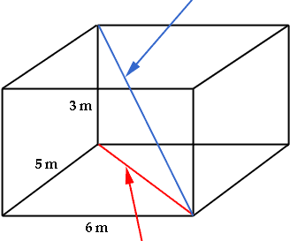
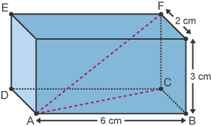
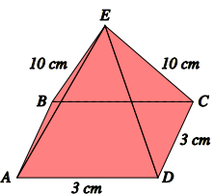
DIRT
Geometry
Pythagoras and Trigonometry Problems
Pythagoras’ theorem is + =
Calculate the length of the line segment AF.
Second diagonal
2cm
Remember to find a logical order to answering the question.
3cm
6cm
First diagonal
What is the formula for area of a triangle?
Calculate the are of the triangle.
10 cm
16 cm
Remember
$$sinθ=\frac{opp}{hyp}$$
$$cosθ=\frac{}{}$$
$$tanθ=\frac{}{}$$
Calculate the angle between the length AE and the base ABCD in the pyramid pictured below, giving your answer to 1 decimal place.
Opposite
Hypotenuse
$$θ$$
Adjacent

Slide 37
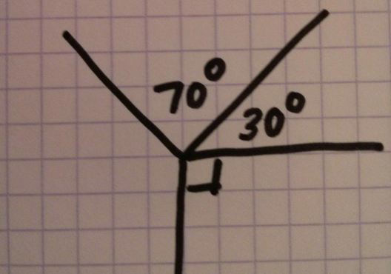
DIRT
Geometry
Missing Angles
The angles in a triangle add up to _________. | Find the missing angle
The angles in a quadrilateral add up to ________. | Find the missing angle
The angles on a straight line add up to_________. | Find the missing angle
The angles around a point add up to _________. | Find the missing angle

Slide 38
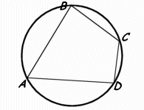
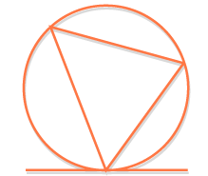
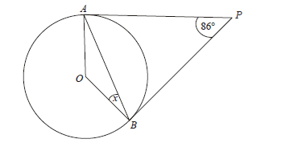
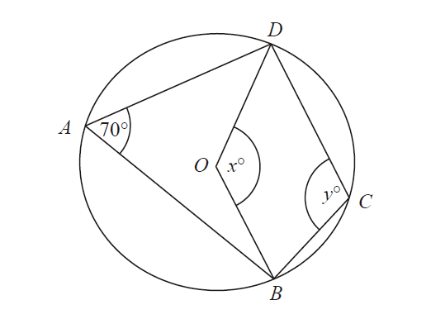
DIRT
Geometry
Circle Theorems
Which circle theorem is represented by this diagram? _________ angles in a __________quadrilateral ______ up to ____________ | Label the angles that are equal and name the circle theorem
The angle between a tangent and a __________ is _______. Mark these angles on the diagram Tangents from a point are ______________________. Use these facts to calculate angle x
Find the value of x and y giving reasons for your answers

Slide 39
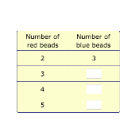
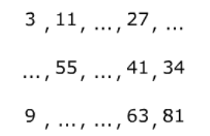
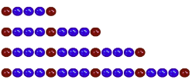
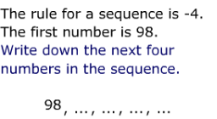
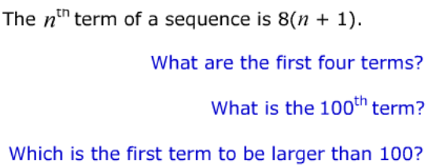
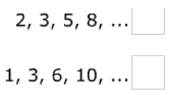
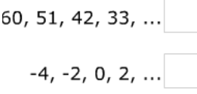
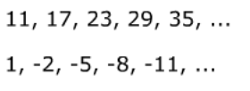
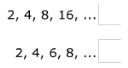
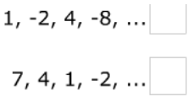
DIRT
Algebra
Sequences
Match the sequence to its rule
Write down the next three terms
Fill in the blanks
Fill in the blanks
Mark each sequence with A (arithmetic)
or G (Geometric)
Write down the formula for the nth term of these sequences

Slide 40
DIRT
Algebra
Notation & Expressions
Fill in the blanks from the word bank below to complete the sentences.
Match each statement to the correct expression.
Six Add Subtract
Subtract a from 3
$$a+3$$
The expression $a+5$ means we
five to $a.$
$$a−3$$
The expression $a−5$ means we
five to $a.$
Add
3 to a
$$3$$
The expression $6−a$ means we subtract a from .
Subtract 3 from a
$$3−a$$
Fill in the blanks from the expression bank below to complete the sentences.
Match each statement to the correct expression.
$$c÷7 c×c 7×c$$
$$b^{2}$$
Multiply b by 3
$$\frac{3}{b}$$
The expression $c^{2}$ means .
The expression $7c$means$.$
Divide b by 3
$$3b$$
The expression $\frac{c}{7}$means .
$$\frac{b}{3}$$
Multiply b by itself
When simplifying expressions we collect like terms together.
For example
$t+t+ + + =5t$
$2t+ =5t$
$8× p=16p$
Simplify the following
$p+p+p+p=$
$7x−2x=$
$3×5g=$
$3x+4y−x+2y=$

Slide 41
DIRT
Algebra
Expansion
Expand means you need to ___________ out the brackets.
Expand the following brackets.
$3\left(x+5\right)$
$2\left(3y−4\right)$
$x\left(x+2\right)$
$$Expand 2(x+3)$$
Use the method your teacher has taught.
$$2\left(x+3\right)$$
$=$ $2x$
 | $$x$$ | $$+3$$
$$2$$
=
Expand and simplify
$$4\left(x−5\right)−3\left(x+7\right)$$
$$=4x −20−3x$$
$$=x$$
Expand and simplify
$2\left(x−5\right)+4\left(x+2\right)$
$5\left(x+3\right)−2(x−4)$
Expand each bracket first.
Simplify by collecting like terms together.
What does the word expand in mathematics mean you need to do?
Expand
$3\left(x+2\right)$
$4(x−3)$

Slide 42
DIRT
Algebra
Expansion
Expand $\left(x+4\right)\left(x−7\right)$
Expand and simplify:
a) ( x + 4 )( x + 9 )
b) ( x + 3 )( x – 5 )
c) ( 3x + 4 )( x –-2 )
× | $$x$$ | $$−7$$
$$x$$ |  | $$−7x$$
$$+4$$
=
$$x^{2}$$
$$−7x$$
=
First Outside Inside Last
Expand and simplify:
a) ( 2x + 1 )( x + 3 )
b) ( 5x – 3 )( x – 5 )
c) ( 3x + 5 )²
$$(2x+5)(4x−3)$$
= $−6x$
$$=8x^{2}$$

Slide 43
DIRT
Algebra
Factorisation
Factorise the following expression:
12 a + 8
Find the numerical highest common factor between each term(12 and 8) = 4
4(3a + 2)
Factorise fully:
6b – 9
36 – 6c
27a – 18b – 9c
12 a + 8
4 goes outside
the bracket
4 x 3a = 12a and 4 x 2 = 8
Factorise the following expression:
12 a + 18
Find the numerical highest common factor between each term(12 and 18) =
Factorise fully:
4b – 12
24 – 6c
14a – 21b +7c
$$6 12a+18$$
So $( + )$
Factorise the following expression:
$4a^{2}+8a$
Factorise fully:
$3a^{2}+2a$
$10b+15b^{2}$
$12ab^{2}+18b$
$$×a× + ×2×$$
So $4a( + )$

Slide 44
DIRT
Algebra
Factorisation
Factorise
Factorise
$x^{2}−8x+15$
$x^{2}−3x−18$
$2x^{2}+10x+8$
$$x^{2}+x−12$$
Times to make
End
Add to make
Middle
What factor pairs multiply to make -12
$$=( x+ )( x− )$$
Be careful of the signs.

Slide 45
DIRT
Algebra
Algebraic Fractions
Express $\frac{3}{x+4}×\frac{2x+5}{2}$ as a single fraction.
Express $\frac{2}{x−7}×\frac{3x+6}{4}$ as a single fraction.
$$=\frac{3\left(2x+5\right)}{2\left(x+4\right)}$$
When multiplying expressions, watch out for expanding brackets.
$$=\frac{3\left(2x+5\right)}{2\left(x+4\right)}$$
Express $\frac{2}{x−2}+\frac{3}{x+5}$ as a single fraction.
Express $\frac{3}{x+6}+\frac{4}{x−8}$ as a single fraction.
$$\frac{2\left(x+5\right)+3\left( − \right)}{\left( + \right)\left(x−2\right)}$$
Expand
Simplify
Simplify fully $\frac{x^{2}+3x+2}{x^{2}−x−6}$
Simplify fully $\frac{x^{2}−7x−8}{x^{2}+5x+4}$
$$=\frac{\left(x+ \right)\left(x+ \right)}{\left(x+ \right)\left(x− \right)}$$
Factorise the numerator and denominator.
$$=\frac{\left(x+ \right)}{\left(x− \right)}$$
Simplify

Slide 46
DIRT
Algebra
Substitution
$$q^{2}=q×$$
$$3q^{2}= × ×$$
If $g=3$what is the value of
${4g}^{2}=4×3×$
$$=$$
Evaluate the following expressions when $x=4 and y=5$
$2x+y=$
$2y^{2}=$
$2x^{2}−2y=$
Use this rule to work out the total cost of hiring a bouncy castle.
Use this rule to work out the total cost of a taxis journey.
$Total cost=£10 per hour plus £$15
$$Total cost=£3 per mile plus £2$$
Michelle hires a bouncy castle for 6 hours.
Maria travels 5 miles in a taxis. Work out the total cost.
$$Total cost=£10× + £15$$
$$Total cost= + £15$$
$$Total cost=$$
The total cost is £125, how many hours did Adam hire the bouncy castle for?.
The total cost of a taxis journey is £23. How many miles did Abdul drive?
$Total cost=£10 per hour plus £$15
$$Total cost=£3 per mile plus £2$$
Cost
$$×10$$
$$+15$$
Hire
Cost
$$÷10$$
$$−15$$
Hire

Slide 47
DIRT
Algebra
Formulae
When we follow a rule we substitute the terms with the corresponding values.
Aiman wants to calculate the momentum of a curling stone.
The stone had a mass of 8kg and velocity of 3 m/s.
Use the rule below to calculate the momentum.
The rule is
Power = Voltage $×$ Current
If the voltage is 12 volts and
the current is 5 amperes.
What the is the power in watts?
Power = 12 $×$
= watts
Momentum = Mass $×$ Velocity
$$c+d=15$$
$$a−b=8$$
c & d could be $c=10$and $d=5$
Write down two different pairs of answers for a and b.
because $10 + 5=15$
Write down two different pairs of answers for c and d.
$a= ______$ and $b=______$
$c= ______$ and $d=______$
$a= ______$ and $b=______$
$c= ______$ and $d=______$
A taxis cost £5 for each mile that it travels. Write this as a formula.
It costs £10 per hour to rent a bouncy castle. Express this as a formula.
Cost =
$$×$$

Slide 48
DIRT
Algebra
Formulae
Find the value of s when
$$a=3, t=2 and u=4$$
Find the value of s when
$$a=2, t=5 and u=3$$
$$s=ut+\frac{1}{2}at^{2}$$
$$s=ut+\frac{1}{2}at^{2}$$
$$s=u× +\frac{1}{2}× ×t^{2}$$
$$s=4× +\frac{1}{2}× ×2^{2}$$

Slide 49
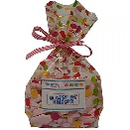
DIRT
Algebra
Forming Equations
Write down an expression for the perimeter of this shape.
Write down an expression for the perimeter of this shape.
$$2x$$
Add the edges together and then collect like terms.
$$2x+5$$
$$x+4$$
$$3x+2$$
The perimeter=26cm what is the value of $x$?
The perimeter=54cm what is the value of $x$?
= 26
Solve for $x$.
Iqbal has 17 pencils all together.
He has a box of pencils and 5 extra pencils.
Write this as an equation.
How many pencils are in the box?
Emily has a 20 sweets all together.
She has two bags of sweets.
Write this as an equation.
How many sweets are in a bag?
I think of a number
I multiply it by 5
and then subtract 6.
The result is also two times the number I’m thinking.
The equation is
What is the number?
Julie thinks of a number. She multiplies it by 4 and adds 16. The result is also six times as big as the number. What is the number?
n
5n
5n
$$x+5$$
Both rectangles have the same area.
What is the value of the missing length?
$$6$$
$$5$$
$$2x−4$$

Slide 50
DIRT
Algebra
Solving Equations
Solve the equations
Solve the equations
$$c+5=9$$
$$t+12=15$$
$$p−8=7$$
$$m−11=14$$
Solve the equations
Solve the equations
$$5y=15$$
$$\frac{m}{5}=4$$
$$2w=14$$
$$\frac{w}{2}=6$$
Solve
$$3x+5=23$$
Solve
$$2x+8=22$$
$$5x−3=17$$
$$3x=$$
$$x=$$
Solve$2\left(x+5\right)=24$
Solve
$$3\left(x+4\right)=27$$
$$+ =24$$
$$2x=$$
$$x=$$

Slide 51
DIRT
Algebra
Solving Equations
Solve the equation
$$3t−9=5t−17$$
Solve the equation
$$5t+12=7t+8$$
$$−3t$$
$$−3t$$
$$−9=2t+17$$
Solve the following equation
Solve the following equation
$$3t−8=5t+20$$
$$2t−6=6t+12$$
$$−3t$$
$$−3t$$
$$−8=2t+20$$
Solve the following equation
Solve the following equation
$$3\left(x+2\right)=4x−7$$
$$2\left(x+2\right)=6x−8$$
Expand
$$3x+6=$$
Solve the following equation
Solve the following equation
$$3\left(x−4\right)=5(x+7)$$
$$5\left(x−7\right)=4(2x−3)$$
Expand
$$3x−12=$$

Slide 52
DIRT
Algebra
Solving Inequalities
Solve
$$6x+5≥4x−11$$
Solve
$$4x+15<8x−16$$
$$≥$$
$$≥$$
$$≥$$
Represent the following solution sets on a number line.
$$x>5$$
$$2x+4<10$$
$$x≤−4$$
Expand
$3\left(x+5\right)$
$2(3x−5)$
Solve the following and represent the solution set on a number line.
$$4\left(3x−5\right)>2x−35$$

Slide 53
DIRT
Algebra
Solving Quadratic Equations
Factorise $x^{2}−2x−15$
$$(x )(x )$$
Solve $x^{2}+4x−21=0$

Slide 54
DIRT
Algebra
Simultaneous Equations
Solve $3x+2y=4$
$$4x+5y=17$$
Aim to get one coefficient value the same.
1000 tickets were sold. Adult tickets cost £8.50, children's cost £4.50, and a total of £7300 was collected. How many tickets of each kind were sold?

Slide 55
DIRT
Algebra
Trial and Improvement
The equation $x^{3}+3x=4$
Has solutions between 3 and 4.
The equation $x^{3}−6x=72$
Has solutions between 4 and 5.
$$x$$ | Output | Big/Small

Slide 56
DIRT
Algebra
Change the Subject
To rearrange equations you follow the reverse order of operations.
Rearrange these formulae to make $m$the subject.
Make $x$ the subject
$$y=x+4$$
$$y =x$$
So $x=$
$$z=5x−3$$
$$z+3= 5x$$
$$\frac{z+3}{}=x$$
1) $p=m−4$
2) $q=7m+5$
+ 3
$$−4$$
$$−4$$
$$÷5$$
Make $x$ the subject of the formula.
Make $x$ the subject of the formula.
$$y=\sqrt{4x+z}$$
$$y=\sqrt{\frac{4x}{5}}$$
The opposite to the square root is to _____________ a number.
$$y^{2}=4x+z$$
Rearrange to make $x the subject of the formula$
Rearrange to make $x the subject of the formula$
$$3\left(x−t\right)=z(p−x)$$
$$p\left(y+x\right)=t(w−rx)$$
$$=zp−zx$$
Expand
Rearrange
$$3x+zx=zp+3t$$
Factorise
$$(3+z)=zp+3t$$
$$x=$$
Rearrange

Slide 57
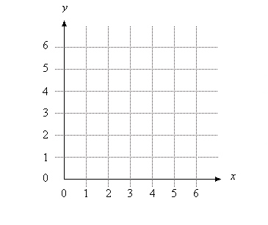
DIRT
Algebra
Coordinates
Plot the missing coordinate to make a square.
What is the coordinate? _______
Plot the missing coordinate to make a rectangle.
What is the coordinate? _______
When plotting coordinates we need to remember the rhyme .
Along the ____________ and up the ___________.
Plot the coordinates
A (3,4) B (2,5) C (0, 3) D (4,0)

Slide 58
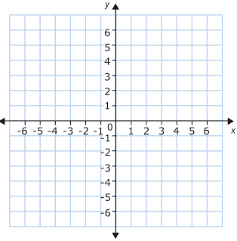
DIRT
Algebra
Coordinates
Write down the coordinates of the points
A _________
B _________
C _________
Plot and label the following coordinates
D $(0, 5)$
E $(−2, 4)$
F $(−3, −4)$
G $(5, −6)$
B
(-3, 2)
A
C
(3, -3)
(-4, -6)
What is the midpoint between these pairs of numbers?
(Midpoint means halfway between)
Here are a set of coordinates
A (0, 4) B (4, 8) C (-2, 1) D (3, -4)
What is the midpoint of the coordinates
A and B
C and B
A and D
4
8
5
10
-6
-2

Slide 59
DIRT
Algebra
Line Graphs
What do you notice about the 3 points?
What is the equation of the line? $x=$
B
C
D
A
What are the equations of the lines
a) c)
b) d)
Plot and connect the following coordinates on the grid. (-2, 5) (1, 5) (3, 5) (6, 5)
What is the equation of the line they make?
Draw and label the lines of
$y=4$
$x=2$
$y=−5$

Slide 60
DIRT
Algebra
Straight Line Graphs
Complete the table using the graph to help you.
$$y=2x$$
$$y=2x$$
$$x$$ | $$−2$$ | $$−1$$ | $$0$$ | $$1$$ | $$2$$
$$y$$ |  | $$−2$$ |  |  | $$4$$
Complete the table, draw and label the graph.
$$y=2x−3$$
$$x$$ | $$−2$$ | $$−1$$ | $$0$$ | $$1$$ | $$2$$
$$y$$ |  |  | $$−3$$
Circle the graphs with a positive gradient.
Match the equation with the correct sketches.
$$y$$
a
$$y$$
$$y$$
$$y$$
c
$y=3x+$4
$$x$$
b
$$x$$
$$x$$
$$x$$
Circle the graphs with the intercept of 4.
$$y$$
$y=−x−$1
$$y$$
a
$$y$$
$$y$$
c
4
2
$$x$$
-2
$$x$$
4
$$x$$
-4
4
$$x$$
$$y$$
$y=2x−$4
b
Identify the gradient (m) and intercept (c) of these equations.
$y=3x−5$
$y=−2x+6$
$$x$$
$y=−2x+$5
Gradient = Intercept =
$$y$$
Gradient = Intercept =
$$x$$

Slide 61
DIRT
Algebra
Graphs
Complete the table, draw and label the graphs.
$$y=x^{2}$$
$$x$$ | $$−2$$ | $$−1$$ | $$0$$ | $$1$$ | $$2$$ | $$3$$
$$y$$ |  | $$1$$ |  |  | $$4$$
$$y=x^{2}−5$$
$$x$$ | $$−2$$ | $$−1$$ | $$0$$ | $$1$$ | $$2$$
$$y$$ |  |  | $−$5 |  | $$−1$$
$$y=x^{2}−2x−3$$
$$x$$ | $$−2$$ | $$−1$$ | $$0$$ | $$1$$ | $$2$$ | $$3$$
$$y$$ | $$5$$ |  | $−$3 |  | $$−3$$

Slide 62
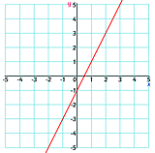
DIRT
Algebra
Equations of a Line
The equation of a straight line is normally in the form.
$$y= x+$$
What is the gradient of the equations?
$2y=8x+10$
$4y=12x−20$
If I have 2 lots of an equation I need to divide the equation by 2.
$$÷2$$
$$2y=6x−8$$
$$÷2$$
$$y= x−4$$
What is the same when lines are parallel?
Which of these lines are parallel?
A
C
E
$$y=3x+2$$
B
$$4y=12x−20$$
D
$$5y−10x=20$$
$$3y=12x−15$$
$$y=2x−3$$
Gradient = $\frac{change in y}{change in x}$
What is the intercept of the graph?
Calculate the gradient of this line.
What is the equation of the line?

Slide 63
DIRT
Algebra
Equation of a Line
When lines are parallel they have the same ________________.
E.g. Calculate the equation of a line parallel to $y=2x+4$, passing through the point $(1,3)$.
Calculate the equation of a line parallel to $y=3x+$5, passing through the point $(2, 6)$.
So, $y=2x+c$
$$3=2×1+c$$
$$3=2+c$$
$$1=c$$
So, $y=2x+1$
Substitute in the coordinate values to find c.
When line graphs are perpendicular to each other the gradients should multiply together to make $−1$.
Are these pairs of lines perpendicular to each other? (True or False)
$$y=5x+8$$ | $$y=−\frac{1}{5}x−3$$
$$y=−3x+6$$ | $$y=3x−\frac{1}{3}$$
$$y=\frac{1}{2}x+3$$ | $$y=−2x+4$$
T
F
What are the missing numbers?
$4× =−1$
$\frac{1}{3}× =−1$

Slide 64
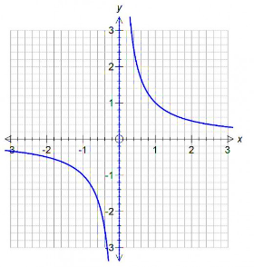
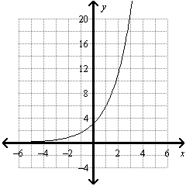
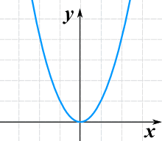
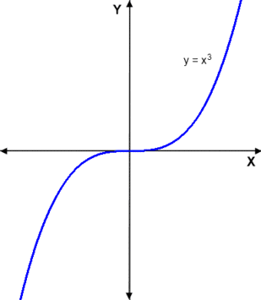
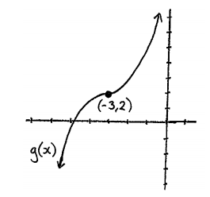
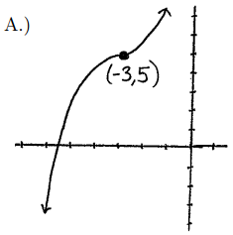
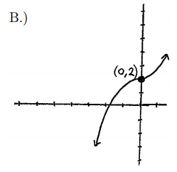
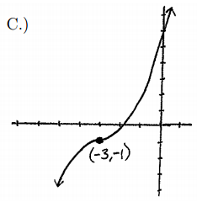
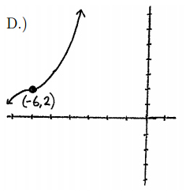
DIRT
Algebra
Graphs
Match the graphs to the equations.
$$y=3^{n}$$
$$y=x^{2}$$
$$y=x^{3}$$
$$y=\frac{1}{x}$$
Given that $g\left(x\right)$ is the graph above math the following graphs with the functions.
$$g\left(x\right)+3$$
$$g\left(x\right)−3$$
$$g\left(x+3\right)$$
$$g\left(x−3\right)$$

Slide 65
DIRT
Algebra
Exponential and Reciprocal Graphs
Complete the table of values for $y={\left(0.6\right)}^{x}$
Note – the variable that changes is the power
$$x$$ | $$0$$ | $$1$$ | $$2$$ | $$3$$ | $$4$$
$$y$$ | $$1$$ | $$0.8$$ |  |  | $$0.13$$
1
Draw the graph $y={\left(0.6\right)}^{x}$
0.8
Use your graph to solve the equation
$${\left(0.6\right)}^{x}=0.4$$
0.6
0.4
Answer _________
Draw the line $y=0.4$, because $y$ has been replaced with $0.4$ so $y=0.4$
0.2
0
1
2
3
4
5

Slide 66
DIRT
Algebra
Solving
The quadratic formula is
$$\frac{−b±\sqrt{b^{2}− }}{}$$
Solve the equation
$$3x^{2}−10x=−5$$
Solve the equation
$$x^{2}+5x−14=0$$
Solve the equation
$$2x^{2}+7x+6=0$$
Solve $\frac{x+3}{5}−\frac{3x}{10}=7$
You need a common denominator.
Solve $\frac{2k+1}{3}−\frac{k−1}{4}=1$
Find the values of a and b such that $x^{2}+10x−9={\left(x+a\right)}^{2}+b$
Find the values of a and b such that $x^{2}−18x+72={\left(x+a\right)}^{2}+b$
Hence solve leaving your answer in surd form.
Complete the Square

Slide 67
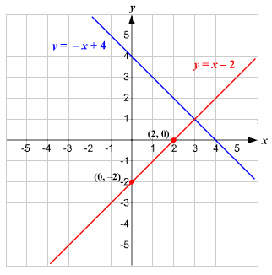
DIRT
Algebra
Subtopic
Show that the $x$ coordinates of the simultaneous equations
$${y=x}^{2}−3x+4$$
$$y−x=1$$
are solutions of
$$x^{2}−4x+3=0$$
Hence solve the simultaneous equations.
$${y=x}^{2}−3x+4$$
$$y−x=1$$
Mark all the integer coordinates with an (x) that are in the region defined by
$$y≥x+4$$
$$y<x−2$$
$$−1<y<2$$

Slide 68
DIRT
Data Handling
Sample Space – Probability
Donna has a box of mixed up gloves. In the box there are 4 different types of gloves cotton, mittens, leather and fingerless. Complete the sample space diagram to show all the possible combinations.
What is the probability Donna picks two of the same gloves?
 | Cotton | Leather | Mitten | Fingerless
Cotton
Leather
Mitten
Fingerless
List all the possible combinations for the meal deal of a drink and sandwich.
Drink | Sandwich
Coke | Tuna
Orange Juice | Ham Salad
Water | Chicken and Bacon
Use a sample space diagram to ensure you don’t miss any combinations.
 | Tuna (T)
Coke (C) | CT
Orange (O)
Water (W)

Slide 69
DIRT
Data Handling
Probability
What does relative frequency mean?
The colour of students hair was recorded in the table below.
Hair Colour | Frequency
Black | 27
Brunette | 36
Blonde | 28
Other | 19
What is the relative frequency of choosing a person at random with blonde hair?

Slide 70
DIRT
Data Handling
Probability
0.5 is the same as _____%
0.35 is the same as _____%
0.05 is the same as _____%
The probability of Middlesbrough winning a match on this seasons figures is 0.7. Out of the 20 games left this season how many would you expect Middlesbrough to win?
The probability of it raining in England is 0.75. What is expect amount of days that it will rain in 364 days?
Probabilities of an event should add together to make ________.
Students were asked to choose their favourite sports. The results are recorded in the table below.
What is the probability that a student chooses Netball?
Sport | Football | Cricket | Netball | Other
Probability | 0.25 | 0.35 |  | 0.3

Slide 71
DIRT
Data Handling
Probability
A coin was thrown 200 times is it fair? Explain your answer.
A dice was rolled 120 times and it’s results recorded in the table below.
Is the dice fair?
Explain your answer
Outcome | Frequency
Heads | 152
Tails | 48
Outcome | 1 | 2 | 3 | 4 | 5 | 6
Frequency | 22 | 19 | 11 | 30 | 21 | 17
I would expect to get _______ heads, instead I got _______. Therefore the coin is ___________ towards ________.
Tabitha has two bags. The first bag contains 2 blue counters and 7 pink counters. The second bag contains 3 blue counters and 5 pink counters. Complete the probability tree diagram.
Bag 1
$$\frac{3}{8}$$
Bag 2
Blue
$$\frac{2}{9}$$
Blue
Pink
Blue
Pink
Pink

Slide 72
DIRT
Data Handling
Probability
Mrs Dunning is organising a school trip. She needs to choose two students at random to be group leaders. There are 4 girls and 5 boys to choose from.
1st Child
2nd Child
Complete the probability tree diagram.
Calculate the probability Mrs Dunning selects both a boy and a girl.
Girl
$$\frac{4}{9}$$
Girl
Boy
Girl
Boy
Boy
The probability that Tom wins his football match is $\frac{1}{5}$and the probability Tom wins his table tennis match is $\frac{2}{7}$.
Football
Tennis
Complete the probability tree diagram.
What is the probability Tom will win both sports matches?
What is the probability Tom will win only one match?
$$\frac{2}{7}$$
Win
$$\frac{1}{5}$$
Win
Lose
Win
Lose
Lose

Slide 73
DIRT
Data Handling
Probability
Daniella and Benjamin are going to the cinema. The probability that Daniella will arrive late is 0.7 and the probability that Benjamin will arrive late is 0.3. What is the probability that both Daniella and Benjamin arrive on time together?
There are three different chocolate bars left in a shop.
There are $3 Dairy Milk, 4 Crunchy Bars$ $$and 5 kit kats$$
Brogan buys two of these chocolate bars at random. Work out the probability that she takes 2 different types of chocolate bar.
Below are the 9 tiles, Jamal takes a tile at random and he does not replace the tile. Jamal then takes a second random tile. Calculate the probability that the number on Jamal’s second tile is LESS than the number on the first tile he took.
5
5
5
6
6
6
6
7
7

